Slide 1

Agent Activity Chart
4/6/2023 2:52 AM
Print User : selenium.automation
Page 1 of 3

Slide 2
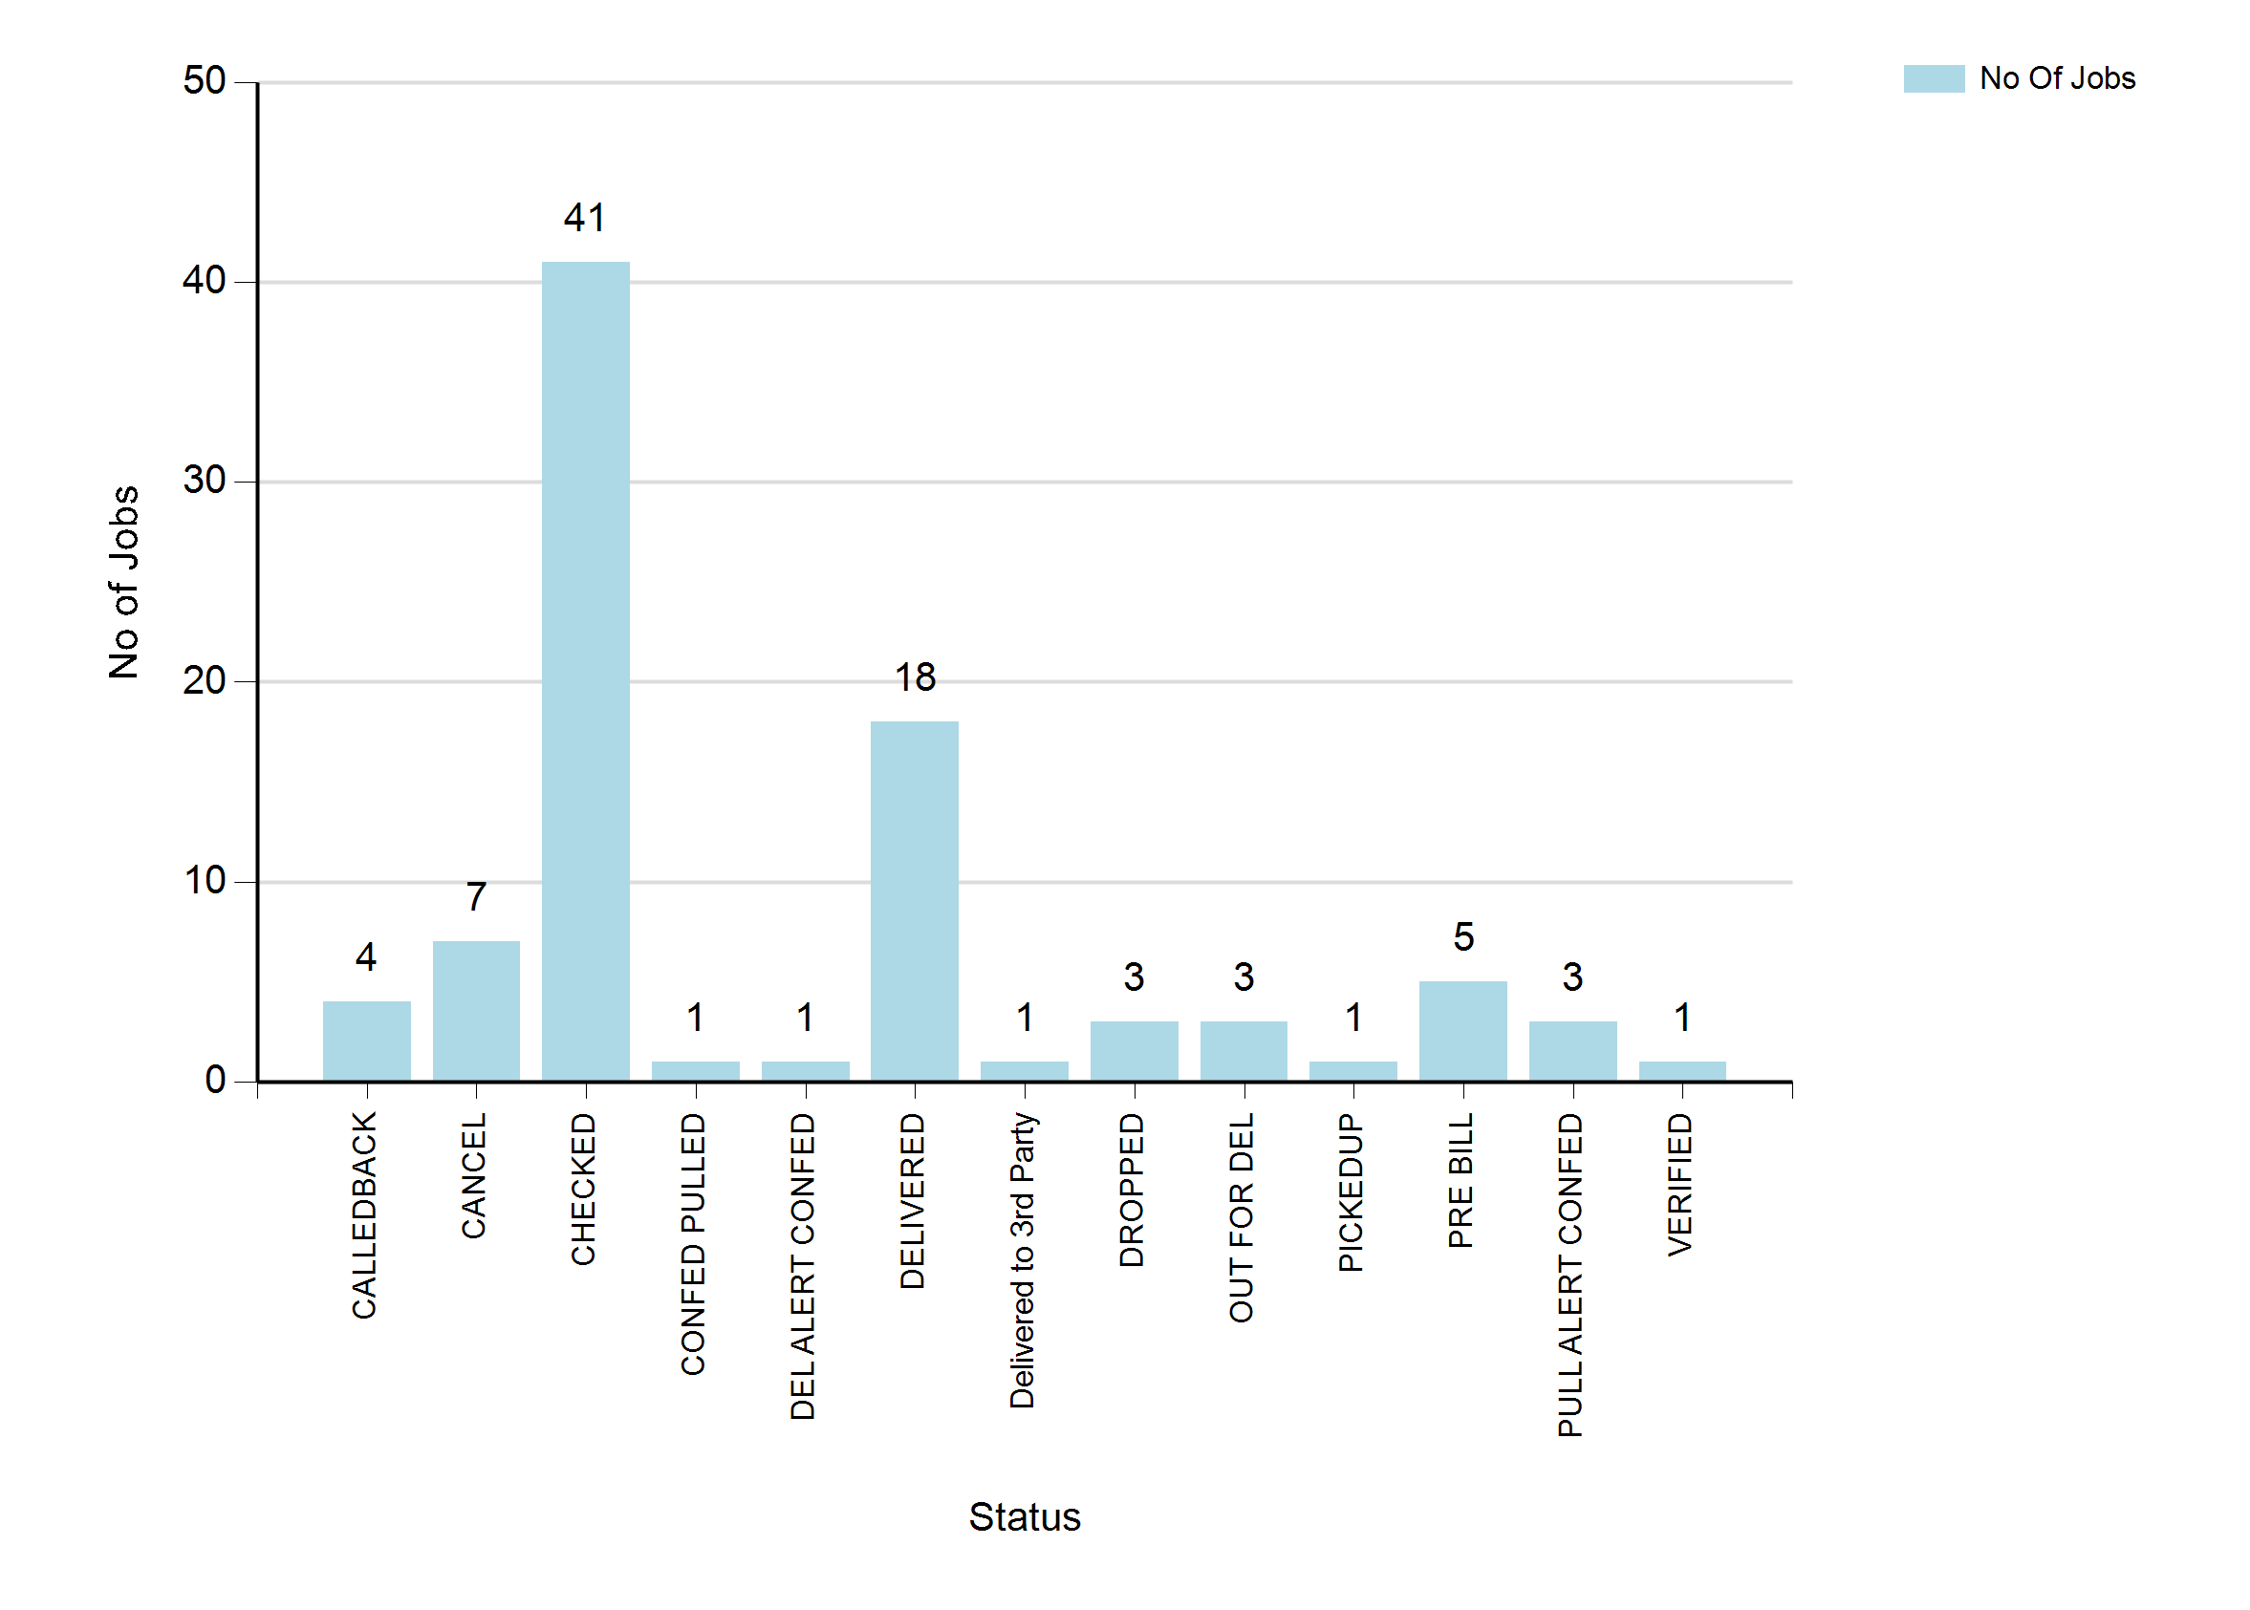
4/6/2023 2:52 AM
Print User : selenium.automation
Page 2 of 3

Slide 3
4/6/2023 2:52 AM
Print User : selenium.automation
Page 3 of 3

